Slide 1
Predicting High-Demand Periods for Seoul Bike Rentals:
A Comparative Analysis of SVM and Decision Tree Models to Optimize Operational Scheduling

Slide 2
01 Business Understanding & Goal
02 Data Preparation
03 Cost-Benefit Matrix
      Find the proper evaluation metric
04 Model Tuning & Comparison
      - Decision Tree: GridSearchCV + Visualization
      - SVM: Baseline + Technical Insight
05 Final Model & Deployment
From Selection to Operational Value

Slide 3
Business Understanding
Seoul's public bike-sharing system is a key component of the city's sustainable urban mobility strategy. The system's efficiency depends heavily on the ability to anticipate demand patterns and ensure bike availability where and when needed.
Current challenges include:
・Supply-demand mismatches
・Operational inefficiency
・Customer dissatisfaction
Business Goal
This project aims to compare two classification models (SVM and Decision Tree) to predict high-demand time periods for bike rentals, using historical temporal and environmental features. By evaluating model accuracy, we will select the optimal model to provide automated early warnings for high-demand periods.
Expected Outcomes:
・Reduce bike shortages during peak hours
・Control cost waste during low-demand periods
・Improved resource utilization efficiency

Slide 4
Data Preparation
2. Added 4 time Features
Convert 'Date' to datetime format
├── Month (1-12)
├── Day (Mon-Sun)
├── Weekend (True/False)
└── Work Day (True/False)
Target Dataset
8465 Instances
15 Features
Raw Data
8760 Instances
14 Features
Cleaned Data
8465 Instances
11 Features
Time Feature-
Enhanced Data
8465 Instances
15 Features
3. Binary Classification
├── Class 0 (Low Demand): 4234 instances (50.02%)
└── Class 1 (High Demand): 4231 instances (49.98%)
Threshold: Median (542)
1. Data Check & Cleaning
✓ Zero missing values confirmed
✓ Non-operating days removed
✓ Simplified column names

Slide 5
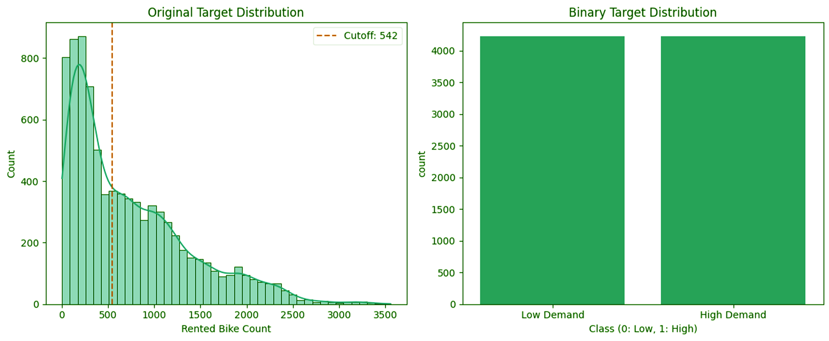
4. Feature Selection & Encoding Process
15 Features
├── Numerical Features : 9
├── Encoded Seasons: 4
└── Encoded Work Day: 2
X Variables
(Feature Dataset)
8465 Instances
15 Features
Y Variables
(Target Dataset)
8465 Instances
1 Features
Split
5. Train-Test Split
Split data into training (75%) and testing (25%) sets
Training set: 6348 Instances
(3175 low, 3173 high)
Test set: 2117 Instances
(1059 low, 1058 high)

Slide 6
Cost-Benefit Matrix -- Find the proper evaluation metric
Business scenario assumption:
A certain bike-sharing company in Seoul hopes to predict whether the next hour will be a "high-demand period" in order to carry out vehicle scheduling and replenishment.
 | Predict High | Predict Low
Actual High | TP | FN
Actual Low | FP | TN

Slide 7
Cost-Benefit Matrix -- Find the proper evaluation metric
Business scenario assumption:
Prediction Outcome | Business Meaning | Cost / Benefit Level | Value Score
TP (predict high, actual high) | ✓ Abundant vehicles meet the demand. ✓ Maximize income ✓ improve the user experience | High Yield | +100
FP (predict high, actual low) | ✗Vehicle idling cost ✗ The waste of maintenance personnel ✓ Brand image maintenance | Moderate costs | -30
FN (predict low, actual high) | ✗ Serious shortage of vehicles ✗ loss of customers ✗ loss in income ✗ negative word-of-mouth | Highest cost (severe negative impact) | -80
TN (predict low, actual low) | ✓Optimal resource allocation ✓ cost control | Moderate income | +50

Slide 8
Cost-Benefit Matrix -- Find the proper evaluation metric
 | Predict High | Predict Low
Actual High | +100 | -80
Actual Low | -30 | +50
The cost of underestimating demand (FN) is 2.67 times that of overestimating demand (FP).
Select the model with the highest demand recall rate

Slide 9
Model 1 Decision Tree -- GridSearchCV
Parameter Range of Training
Best Parameter Result
max_depth:
[2, 3, 5, 7, 10, 15, 20, 25, 30, None]
min_samples_leaf
[50, 75, 100, 125, 150, 175, 200, 225, 250, 275, 300, 350, 400, 450, 500, 600, 700]
min_samples_split
[50, 100, 150, 200, 250, 300, 400, 500, 600]
max_depth:
5
min_samples_leaf
125
min_samples_split
300
GridSearchCV
5-fold
Balancing complexity and generalization ability
Avoid making unreliable judgments based on a small sample size
High threshold for division , ensure the model stability

Slide 10
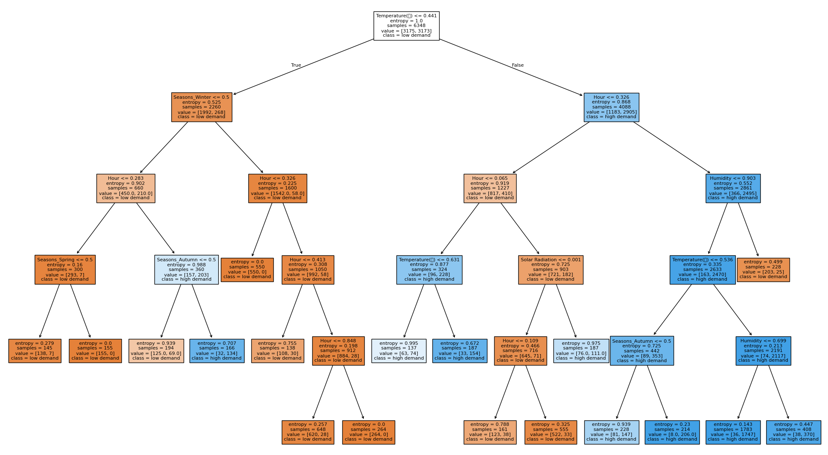
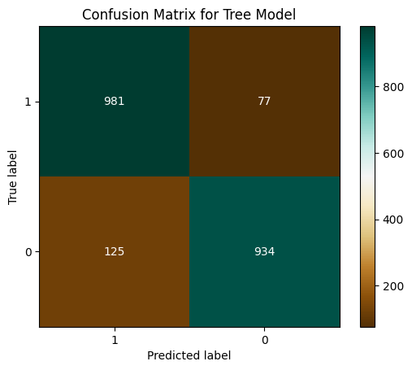
Model 1 Decision Tree -- Visualization
Test - Recall for the best params: 92.72%
Train - Recall for the best params: 93.10%

Slide 11
Model 2 SVM -- Baseline & Technical Insight
Task & Core Objective:
Binary Classification (High=1, Low=0) → Optimize Recall (Minimize FN Loss)
Key Tuning & Result
GridSearchCV |  | Best | Purpose
C | [1,10,100] | 100 | Cover common value ranges; Balance overfitting
kernel | [linear] | linear | Simplify model for real-time forecasting
Technical Highlights:
Linear kernel fits real-time needs; stable in high-dimensional data → Alternative model

Slide 12
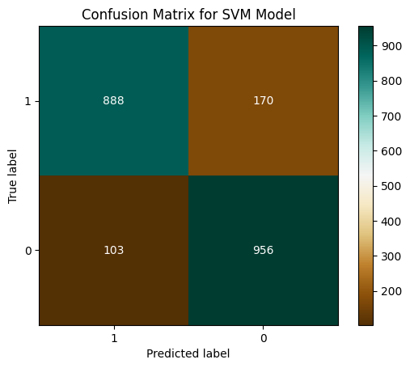
Model 2 SVM -- Visualization
Test - Recall for the best params: 83.93%
Train - Recall for the best params: 82.98%
Note: True label=1 denotes high demand
FN=170 (high demand misclassified as low demand)

Slide 13
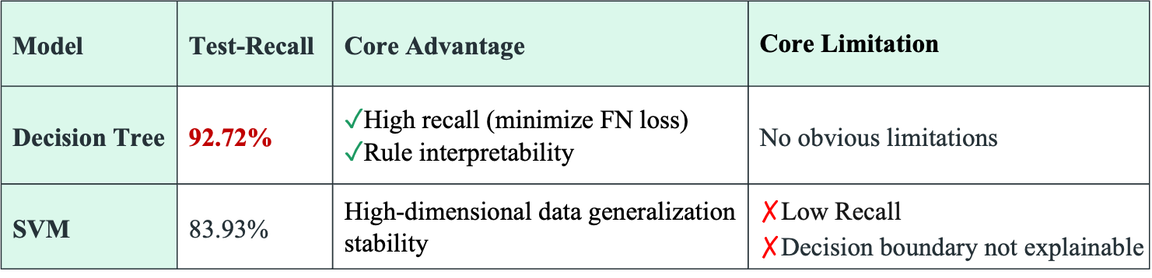
Model Comparison -- Recall + Business Value Driven
Why Decision Tree is the Best Fit?
Model | Test-Recall | Core Advantage | Core Limitation
Decision Tree | 92.72% | ✓High recall (minimize FN loss) ✓Rule interpretability | No obvious limitations
SVM | 83.93% | High-dimensional data generalization stability | $\text{✗}$Low Recall $\text{✗}$Decision boundary not explainable

Slide 14
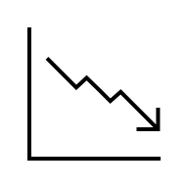
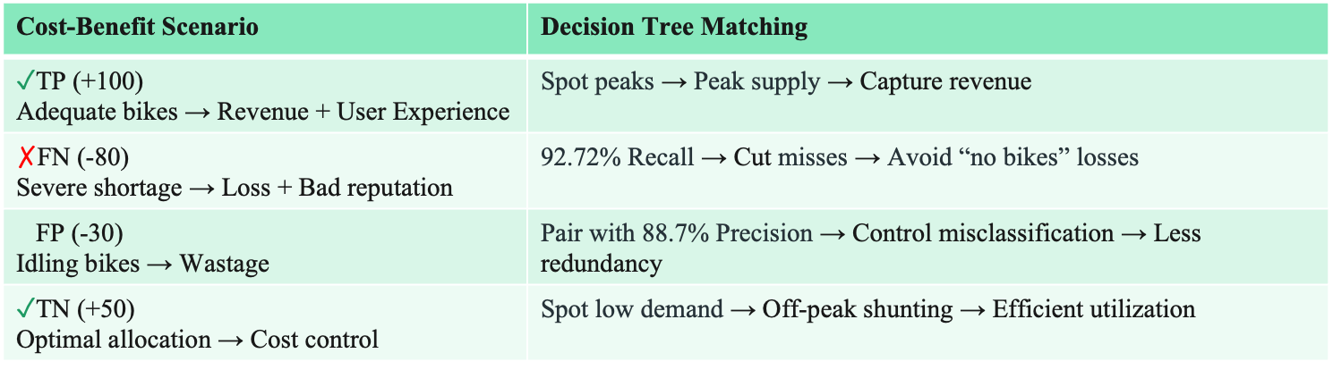
Decision Tree: Perfect Fit for Cost-Benefit Matrix
How Model Capabilities Address Each Scenario?
Cost-Benefit Scenario | Decision Tree Matching
✓TP (+100) Adequate bikes → Revenue + User Experience | Spot peaks → Peak supply → Capture revenue
$\text{✗}$FN (-80) Severe shortage → Loss + Bad reputation | 92.72% Recall → Cut misses → Avoid “no bikes” losses
FP (-30) Idling bikes → Wastage | Pair with 88.7% Precision → Control misclassification → Less redundancy
✓TN (+50) Optimal allocation → Cost control | Spot low demand → Off-peak shunting → Efficient utilization

Slide 15
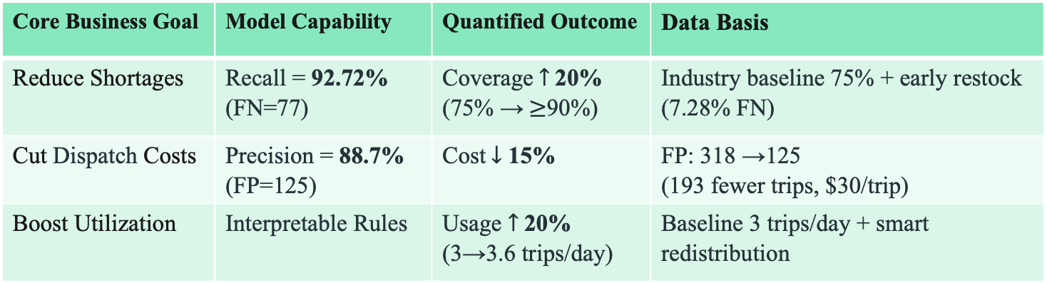
Business Outcomes: Decision Tree Delivers Tangible Value
Data-Driven Results for 3 Core Goals
Core Business Goal | Model Capability | Quantified Outcome | Data Basis
Reduce Shortages | Recall = 92.72% (FN=77) | Coverage$↑$20% (75% →$≥$90%) | Industry baseline 75% + early restock (7.28% FN)
Cut Dispatch Costs | Precision = 88.7% (FP=125) | Cost$↓$ 15% | FP: 318 →125 (193 fewer trips, $30/trip)
Boost Utilization | Interpretable Rules | Usage $↑$20% (3→3.6 trips/day) | Baseline 3 trips/day + smart redistribution

Slide 16
Thanks!

